Slide 1



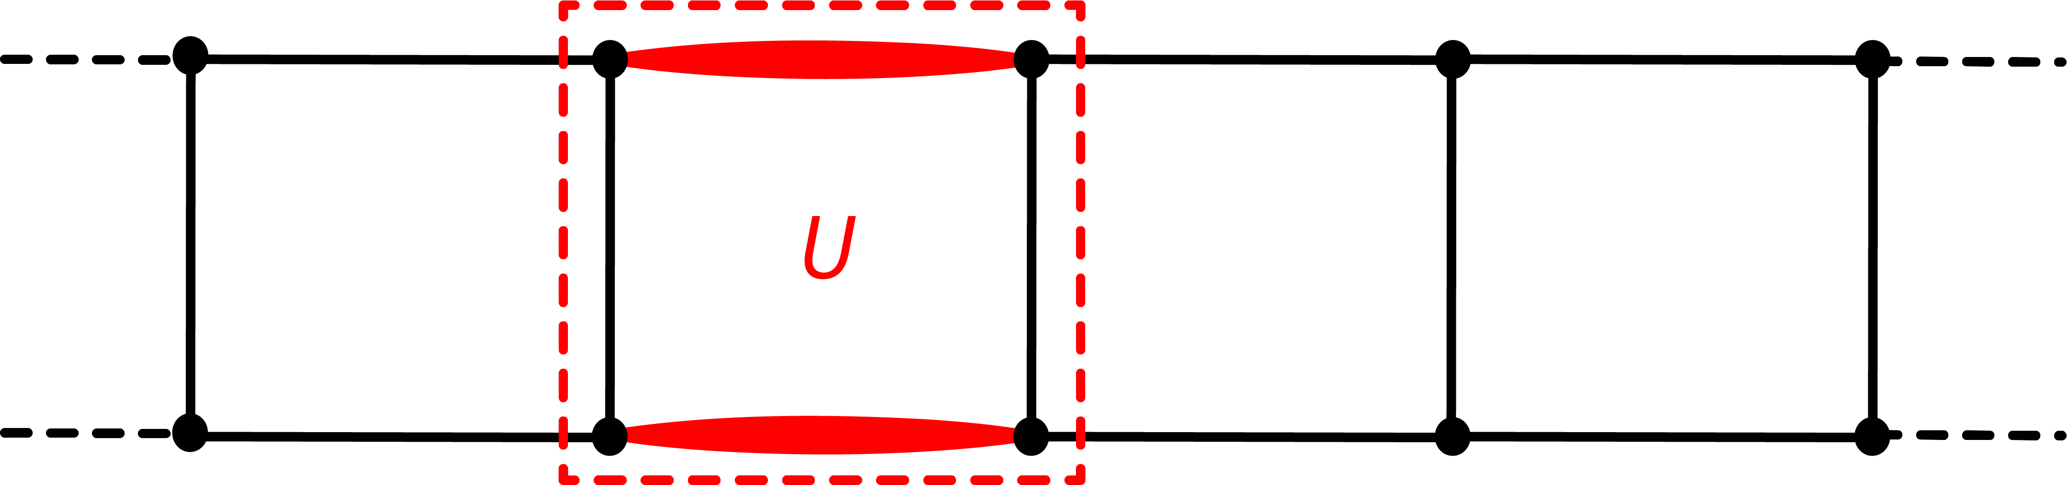
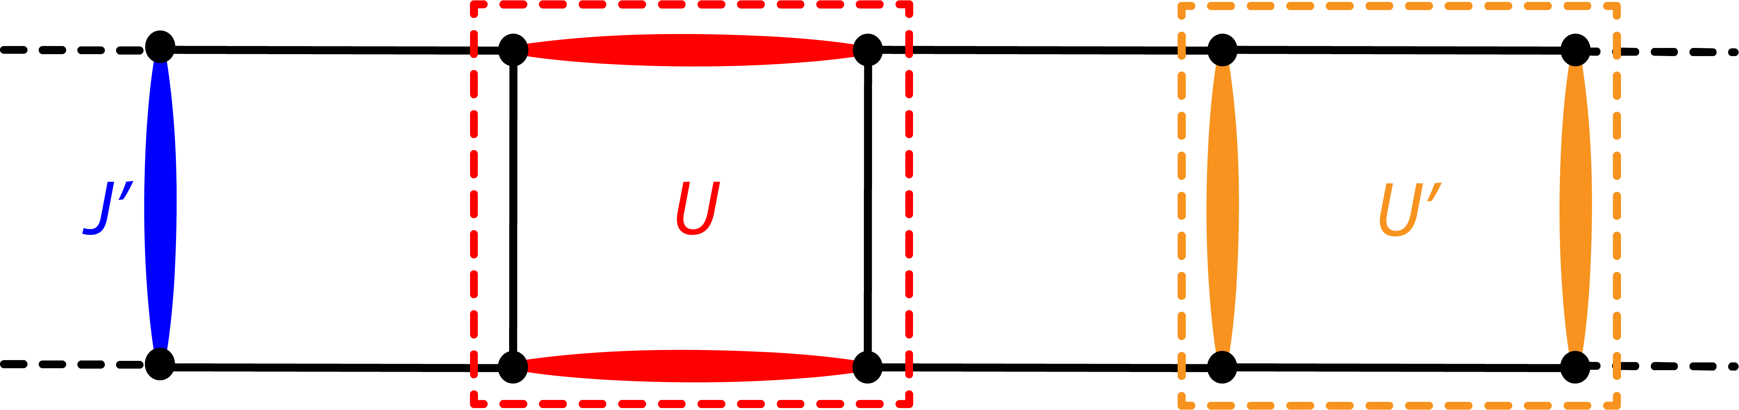
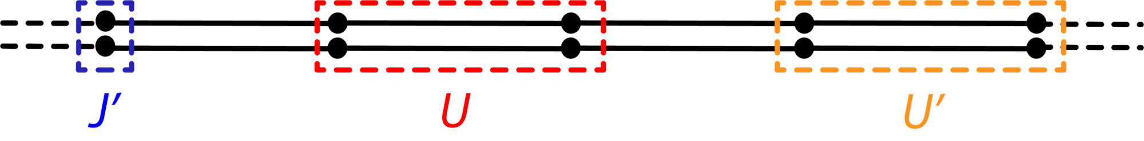
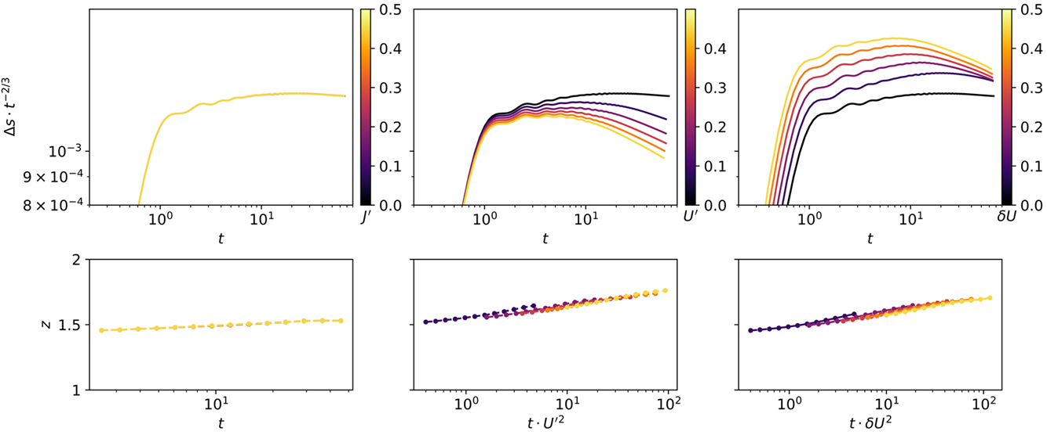


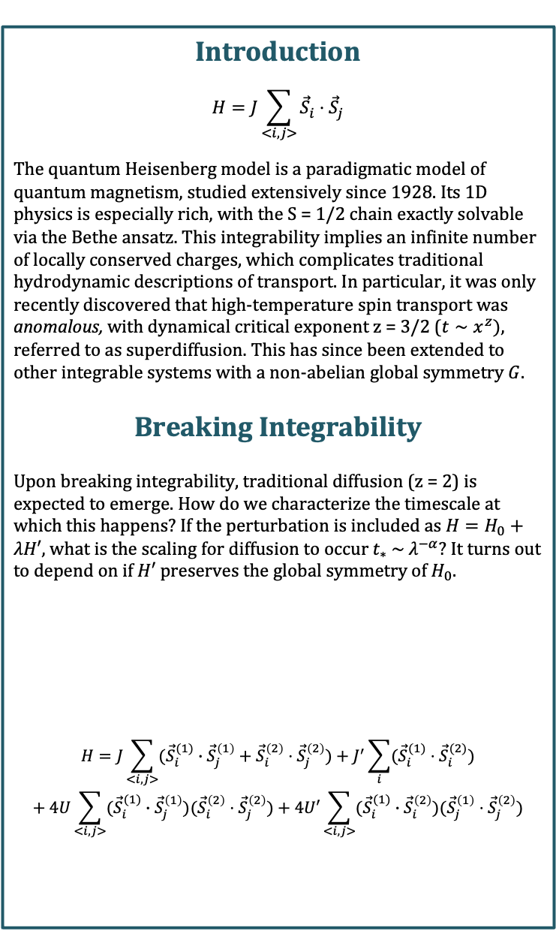




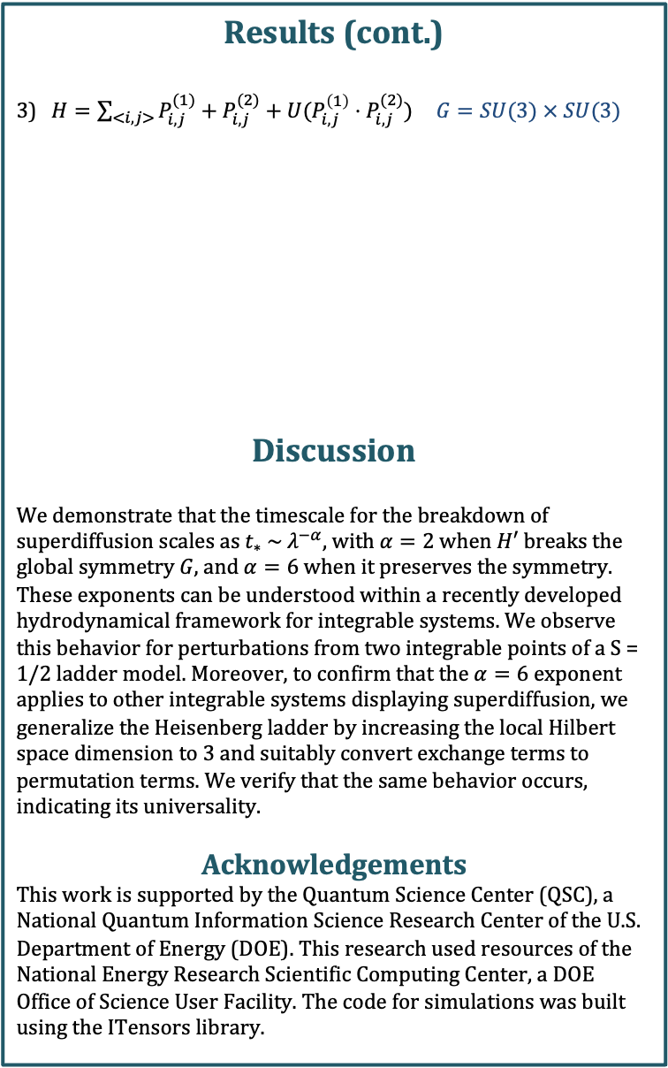



Breakdown of Superdiffusion in Perturbed Quantum Integrable Spin Chains and Ladders
Kevin Wang, Joel Moore
Department of Physics, University of California, Berkeley
Introduction
$$H=J\sum_{<i,j>}{{\vec{S}}_{i}}⋅{\vec{S}}_{j}$$
The quantum Heisenberg model is a paradigmatic model of quantum magnetism, studied extensively since 1928. Its 1D physics is especially rich, with the S = 1/2 chain exactly solvable via the Bethe ansatz. This integrability implies an infinite number of locally conserved charges, which complicates traditional hydrodynamic descriptions of transport. In particular, it was only recently discovered that high-temperature spin transport was anomalous, with dynamical critical exponent z = 3/2 ($t∼x^{z})$, referred to as superdiffusion. This has since been extended to other integrable systems with a non-abelian global symmetry $G$.
Breaking Integrability
Upon breaking integrability, traditional diffusion (z = 2) is expected to emerge. How do we characterize the timescale at which this happens? If the perturbation is included as $H=H_{0}+λH′$, what is the scaling for diffusion to occur $t_{∗} \sim λ^{−α}$? It turns out to depend on if $H′$preserves the global symmetry of $H_{0}$.
$$H=J\sum_{<i,j>}{({\vec{S}}_{i}^{(1)}}∙{\vec{S}}_{j}^{\left(1\right)}+{\vec{S}}_{i}^{\left(2\right)}⋅{\vec{S}}_{j}^{\left(2\right)})+J^{′}\sum_{i}{({\vec{S}}_{i}^{(1)}⋅{\vec{S}}_{i}^{(2)})}$$
$$+ 4U\sum_{<i,j>}{({\vec{S}}_{i}^{(1)}}∙{\vec{S}}_{j}^{\left(1\right)})({\vec{S}}_{i}^{\left(2\right)}⋅{\vec{S}}_{j}^{\left(2\right)})+4U′\sum_{<i,j>}{({\vec{S}}_{i}^{(1)}}∙{\vec{S}}_{i}^{\left(2\right)})({\vec{S}}_{j}^{\left(1\right)}⋅{\vec{S}}_{j}^{\left(2\right)})$$
Measuring Transport
$ρ_{μ}\left(t=0\right)∼\exp\left(μS_{left}^{z}\right)⋅\exp\left(−μS_{right}^{z}\right)$ $μ≪1$
$Δs\left(t\right)≡{\left\langle S_{left}^{z}\left(t\right)−S_{left}^{z}\left(0\right)\right\rangle }_{μ}$ $∼t^{1/z}$
We use matrix product state (MPS) simulations of time evolution from an inhomogeneous quench, measuring charge transport across center. We estimate$z(t)$using power law fits over scanning time windows.
Results
1) ${ H}_{0}=\sum_{<i,j>}{({\vec{S}}_{i}^{(1)}}∙{\vec{S}}_{j}^{\left(1\right)}+{\vec{S}}_{i}^{\left(2\right)}⋅{\vec{S}}_{j}^{\left(2\right)}) G=SU(2) × SU(2)$
2) ${ H}_{0}=\frac{1}{4}\sum_{<i,j>}{P_{i,j}}$ $G=SU(4)$
Results (cont.)
3) $H=\sum_{<i,j>}{P_{i,j}^{(1)}+P_{i,j}^{(2)}+U(P_{i,j}^{\left(1\right)}⋅P_{i,j}^{(2)})} G=SU(3) × SU(3)$
Discussion
We demonstrate that the timescale for the breakdown of superdiffusion scales as $t_{∗} \sim λ^{−α}$, with $α=2$when $H′$breaks the global symmetry $G$, and $α=6$when it preserves the symmetry. These exponents can be understood within a recently developed hydrodynamical framework for integrable systems. We observe this behavior for perturbations from two integrable points of a S = 1/2 ladder model. Moreover, to confirm that the $α=6$ exponent applies to other integrable systems displaying superdiffusion, we generalize the Heisenberg ladder by increasing the local Hilbert space dimension to 3 and suitably convert exchange terms to permutation terms. We verify that the same behavior occurs, indicating its universality.
Acknowledgements
This work is supported by the Quantum Science Center (QSC), a National Quantum Information Science Research Center of the U.S. Department of Energy (DOE). This research used resources of the National Energy Research Scientific Computing Center, a DOE Office of Science User Facility. The code for simulations was built using the ITensors library.
$$d=2→3$$
$G$-invariant
$G$-breaking
$G$-breaking
$G$-invariant
$G$ chemical
potential
$G$-breaking
$G$-breaking

